Slide 1
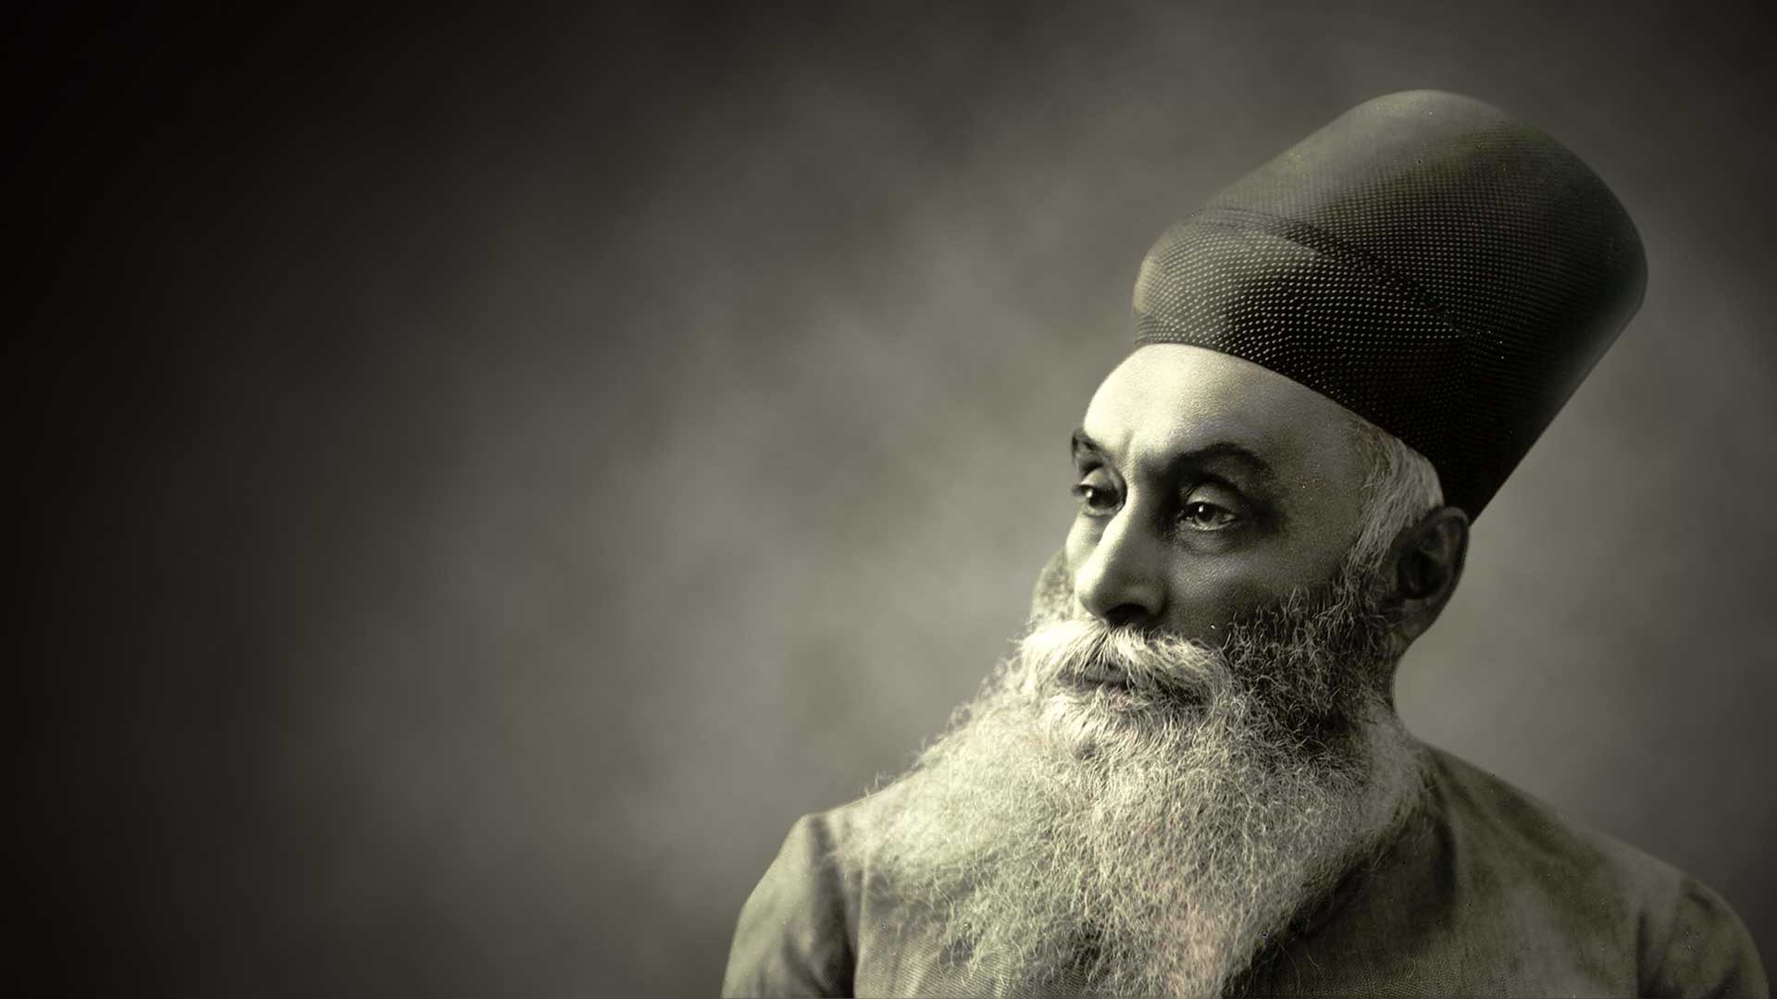
JAMSETJI TATA
THE INDUSTRIAL TYCOON OF INDIA
Creative thinking, Problem solving and Innovation

Slide 2
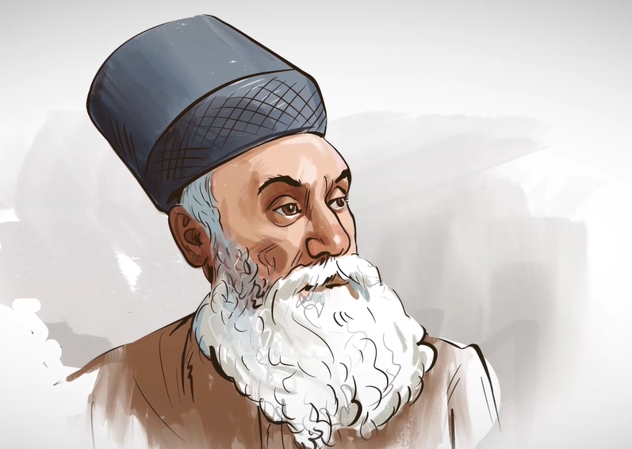
BACKGROUND
“We are a mixed economy. We will remain a mixed economy. The public and private sectors will continue to play a very important role. The private sector in our country has very ample scope and I am confident that India's entrepreneurs have the capacity, and the will to rise to the occasion.” - Jamsetji Tata.

Slide 3
CPI STRATEGY EMPLOYED
He was a man of innovation and high intelligence who always believed and said that “With honest and straightforward business principles, close and careful attention to details, and the ability to take advantage of favourable opportunities and circumstances, there is a scope for success.”

Slide 4

STRATEGY
Collaboration across networks and leading by influence

Slide 5

COTTON DEMAND EXPLODES AND HE SAW A WAY TO INDUSTRIALISE THE SECTOR!
Demand for cotton in India shot up to such an extent that in 1860, India was supplying just 31 % of British cotton imports. But by 1862 this number shot up to 90 % – and this marked the beginning of the cotton revolution in India.
He was even refused loans because the financier saw no potential in a mill being built in Nagpur as opposed to Bombay.
He was even refused loans because the financier saw no potential in a mill being built in Nagpur as opposed to Bombay.

Slide 6
He was refused loans for mill & yet he introduced schemes like medicals funds, etc.
By setting up a high-quality cotton mill that will sell world-class cotton to the world. During that time, Bombay was the first choice to start a cotton mill because of its proximity to the port.
He was even refused loans because the financier saw no potential in a mill being built in Nagpur as opposed to Bombay.
During the initial times, things were so bad that the mill was always working with only 80 % attendance over here. This was the same time when, despite being in our motherland, the Britishers started their atrocities and put- up boards that said- dogs and Indians were not allowed outside the British premises.

Slide 7
The biggest Philanthropist world has ever seen!
The most astonishing thing about this wonderful person is that he donated so much of his wealth that, when adjusted for inflation, the value of his donation is $102 billion, which is even beyond Bill Gates's contribution. – And this makes him the most philanthropic person in the 20th century.

Slide 8


DESCRIPTION OF THE CONCEPT AND SOLUTION - STRATEGIES USED!
BRAINSTORMING - (Here), Jamsetji Tata alongside his father Nusserwanji Tata strategized to raise employment and business in times when both weren’t prevalent in India.
DIVERGENT THINKING - Divergent Thinking is a thought process used to generate many creative ideas by exploring multiple possible solutions to a problem in a non-linear, spontaneous mode of thinking.

Slide 9

OUTCOME
There exist many problems out there in the world but only a few or a handful number of people are able to approach the problem in certain ways that not only solve the issue but also leave a long-lasting impact on the whole world making it a better place in regard to the problem and it’s the solution.

Slide 10

MEMBERS
SHIVANG GULATI – 220905264 – CJ 92
SHANIAA SEN – 220968102 – CJ 60
AMULYA PARASHAR – 220962046 – CJ 45
PARTH GHIYA – 220962224 – CJ 82
NAKUL SINDHWANI – 220933102 – CJ 07
HARSHIT GARG – 220934050 – CJ 09

